Slide 1
ハートビートメソッド 練習方法

Slide 2
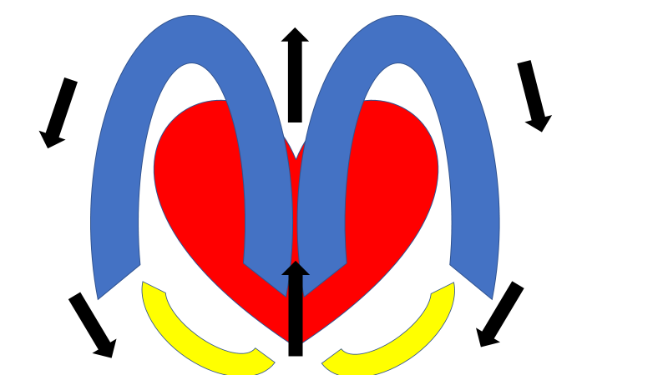
London bridge is falling down
falling down falling down
London bridge is falling down
My faire lady

Slide 3
1, I gave her socks.
2, I gave her the socks.
3, I gave her other socks.
4, I gave her a pair of socks.

Slide 4
1.They bought the books .
2.They bought up the books.
3.They bought up all the books.
4.They bought up all of the
books.

